Slide 1
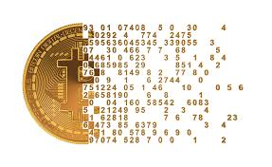
Modeling
Bitcoin Price
Yichen
Junyi
Junzhe
Meizi
Shengqi
Li
Qian
Yin
Yu
Zhou

Slide 2
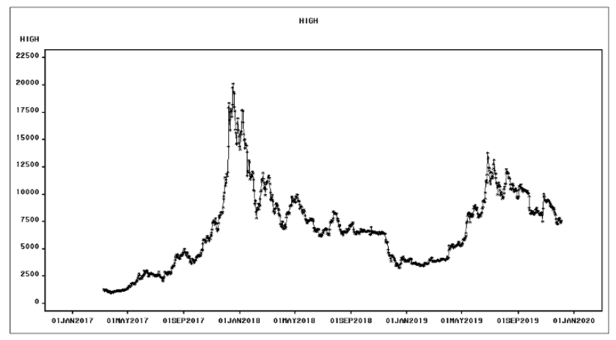
Introduction: Bitcoin
1
1000 observations, 30 or 40 hold out samples
Date : from Mar 10, 2017 to Dec 04, 2019
High : highest recorded trading price of the day
Volume : the monetary value of the currency traded in a 24 hour period, denoted in USD
Notes:
-Cryptocurrency is the digital currency. Its unit generation and fund transfers are decentralized and regulated by encryption methodologies. Bitcoin has the largest share in the total capitalization of cryptocurrency market.
-Since its launch in 2009, it has become widely popular amongst various kinds of people because its trading system doesn’t need a third party and’ also due to high volatility of Bitcoin price.
-We want to understand what drives the fluctuations of the bitcoin exchange price and to what extent they are predictable. Our goal of this project is to analyze and predict how highest price behave through a detailed time series analysis using the Bitcoin Historical data. For investors it can be an added advantage ‘that they model the series for any future investment and making larger margin profits. Short term forecasting is really good for trading.
-There are a total of 1000 observations in our data.
-The dataset contains the opening and closing prices of bitcoins from Mar 10, 2017 to Dec 04, 2019. We also have High, Close,and Volume for Variables. To save time, we will mainly focus on the highest trading price of the day because of its better performance and Volume for further multivariate model.
----As we can observe from the time series graph, there is a slightly upward trend among this 2 year and a half period for Bitcoin highest price of the day.
-We didn’t see an clear seasonality. With alternate high and lows
-Obviously, there is an explosive price move in 2017 that was an outlier. The highest price Bitcoin ever reached until today was around $20,000 on December 18th 2017. commentators and critics called this a price bubble. Indeed, just a few weeks later, the price bitcoin fell rapidly, crashing all the way down below $7,000 by April 2018.
-Since Bitcoin has a quite strong price volatility, let’s c wt the boxplots can bring us.

Slide 3
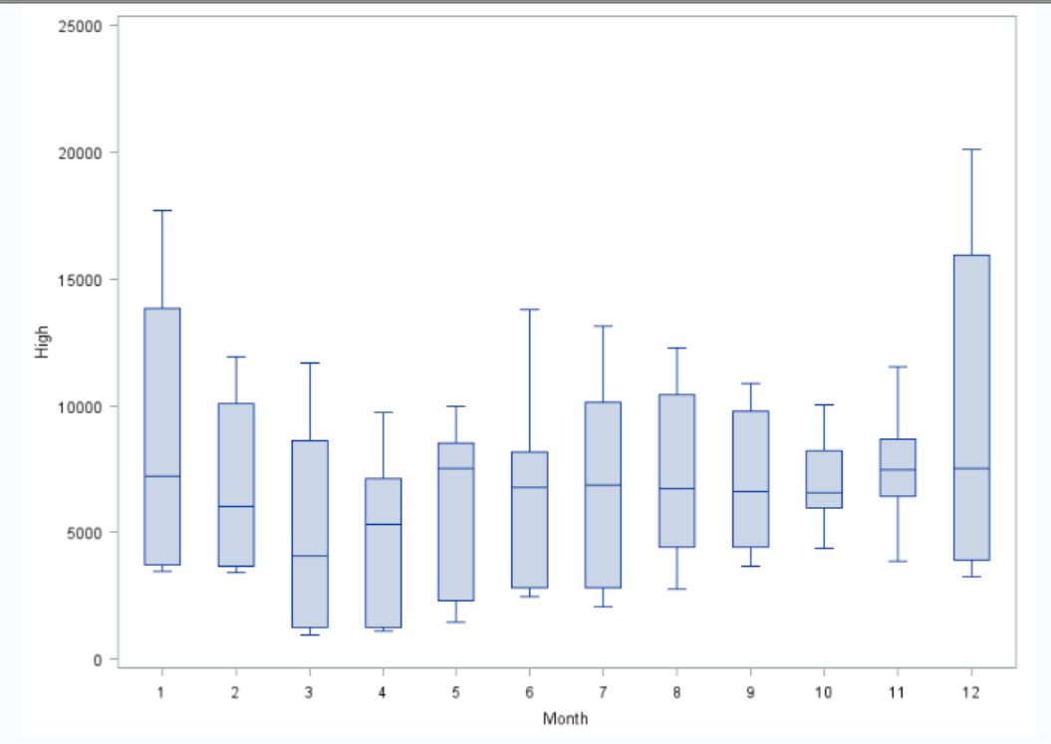
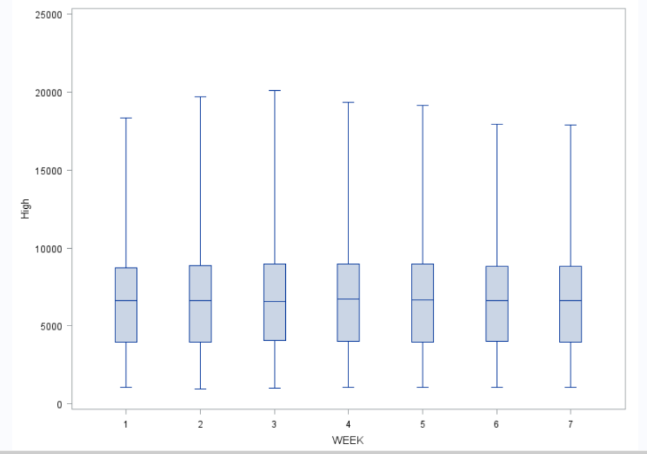
Box Plot
Notes:
-While March is typically a weak month for Bitcoin. May and June are two of the strongest months of the year. No much difference in median from June to end. Of course the November and December also have perform relatively well.
- median of the seven day of the week are very similar.

Slide 4
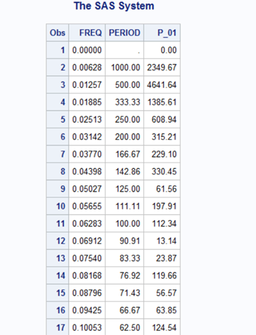
Periodogram table of High
Top 11 P-value：lag 1, 2, 3, 4, 5, 6, 7, 9, 10, 13, 16
Linear trend+sine+cosine
MAPE(40)<MAPE(30)
30 hold-out sample is better
30 hold-out sample+AR(2)
30 hold-out sample
40 hold-out sample
Notes:
I will introduce the deterministic Time Series Models and Error model part. To begin with, we choose HIGH column to build a cyclical trend model.
From the plot of high series periodogram, we can see the observation 2 to 8, 10, 11 14 ,17 have the top 11 P-values and their value are all over the 100, which means these lags might have hidden terms to explain the extraordinary large value, so we decide use lag 1 to 7, lag 9 10, 13, 16 to create sine and cosine terms as regressor, and then we fit the linear and cyclical model.Then, according to Professor your suggestion, we decide to choose the size between 30 to 40 as hold out sample size. And why we don’t choose required 15% as hold-out sample, the reason will be explained by our group member Shengqi in part 4. By comparing the MAPE(Mean absolute percentage error)of 30 and 40, we select 30 because it has lower MAPE value and fit the series better.

Slide 5
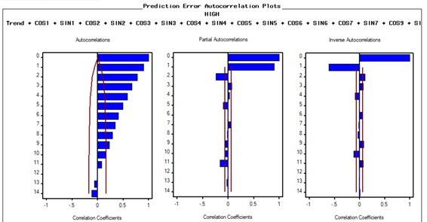
30 hold-out Sample Cyclical Model
2
30 hold-out sample:
The ACF decaying slowing
non-stationary
PACF Chopped off at lag 2
AR(2) model
MAPE of AR(2) is Lowest
Cyclical model + AR(2) best
Cyclic model：
Linear tread+cos1+sin1+cos2+sin2+...+cos7+sin7+cos9+sin9+cos10+sin10+cos13+sin13+cos16+sin16
Notes:
After that, we see the ACF and PACF of 30 hold-out sample model, the ACF decaying slowly which means it is non-stationary, so the series need error model to refit a perfect outcome, and when we see the PACF plot, we find that PACF is chopped off at lag 2, so AR(2) model will be a good error model for the series.

Slide 6
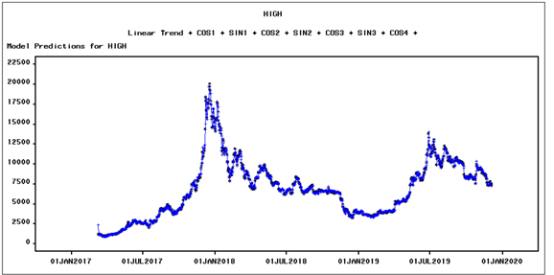
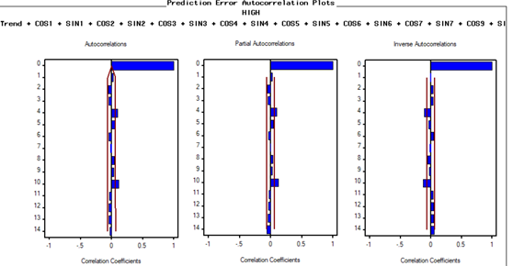
Cyclical model + AR(2)
Notes:
And luckily, the MAPE of AR(2) model is 2.1, which is significantly lower than the original 30-hold-out sample model’s MAPE, and ACF decaying quickly so the new model is stationary.

Slide 7
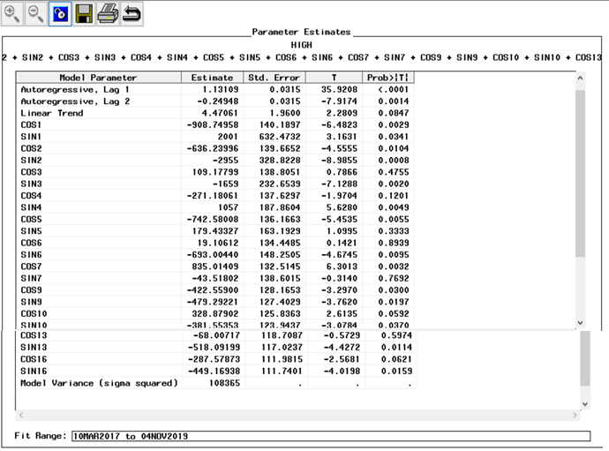
Parameter estimated &Function
Notes:
In addition, there is the parameter estimated table of the new AR(2) model, according to the table, we could write the our forecasting function based on those coefficient. . Next, we will have Meizi to introduce the ARIMA model part.

Slide 8
ARIMA Model
3
Non Stationary
Difference Stationary TS
ARIMA(p,d,q)
d : After dth differenced series is stationary
p : PACF chopped off after Lag p
q : ACF chopped off after Lag q
Notes:
Now we are going to talk about how we build ARIMA models in our project. ARIMA Model can be applied when the time series is non-stationary and the differenced series is stationary. For stationary time series, the ACF decays quickly as the lag increases. Nonstationary time series have ACF that decays very slowly with the lag. There are some relevant parameters d,p,q, here.
Let’s now look at the ACF of our original time series.

Slide 9
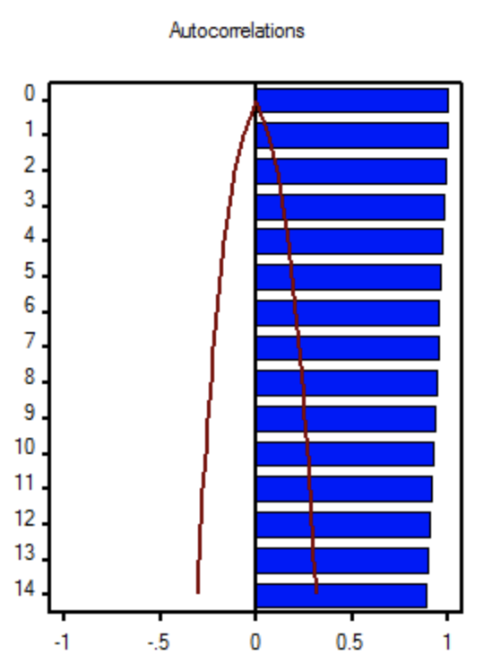
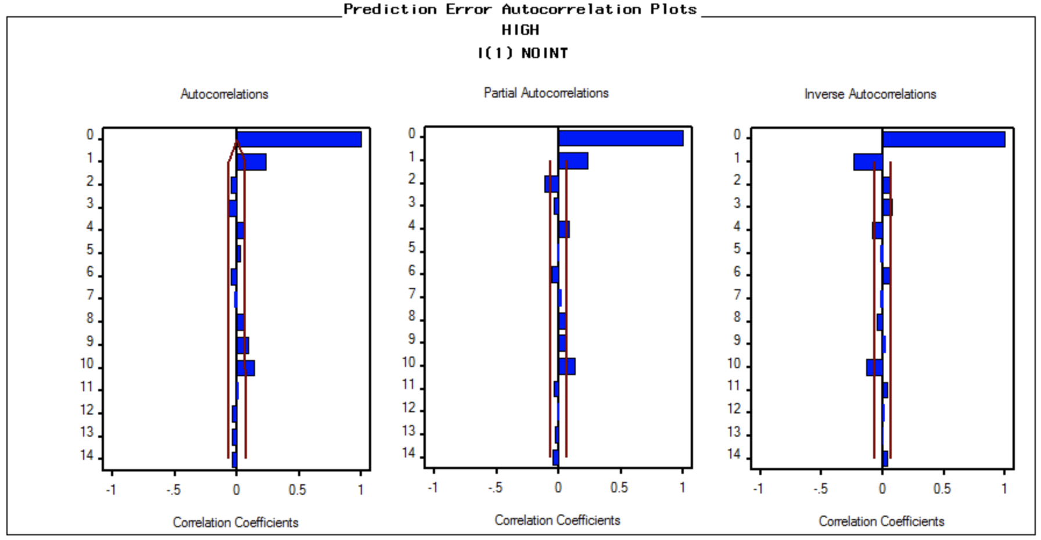
ACF of HIGH
ACF after first differencing q=1
PACF after first differencing
p= 2 or 1
Notes:
The ACF graph in the left shows that the original time series which is obviously not stationary. So we did first differences. We can see the ACF after first differencing in the middle, it shows that the first differenced time series is stationary. So that we can develop ARIMA model here.
Moreover，If we interpret the ACF chopped off after Lag 1 and the PACF decaying quickly, that is d = 1, q = 1, ARIMA(0,1,1) can be applied.
If we interpret the ACF decaying quickly and PACF chopped off after Lag2 or Lag 1 that is d =1, p =2 or 1, ARIMA(2,1,0) or ARIMA(1,1,0) can be applied. The hold out sample we used is 30 for ARIMA models.

Slide 10
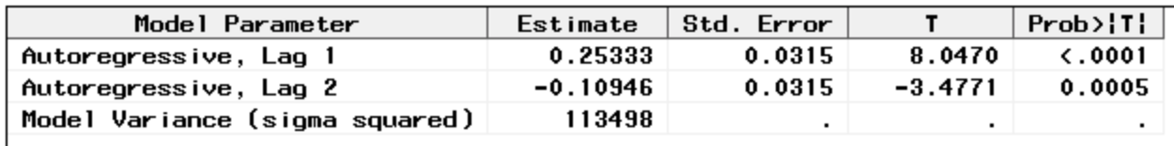
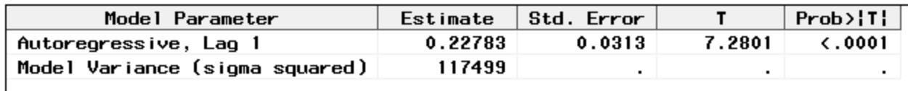
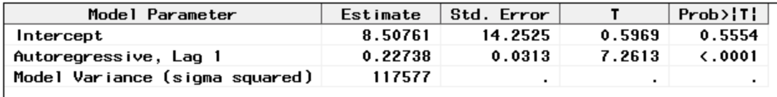
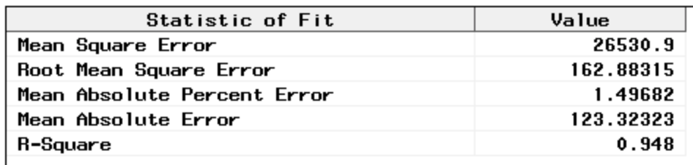
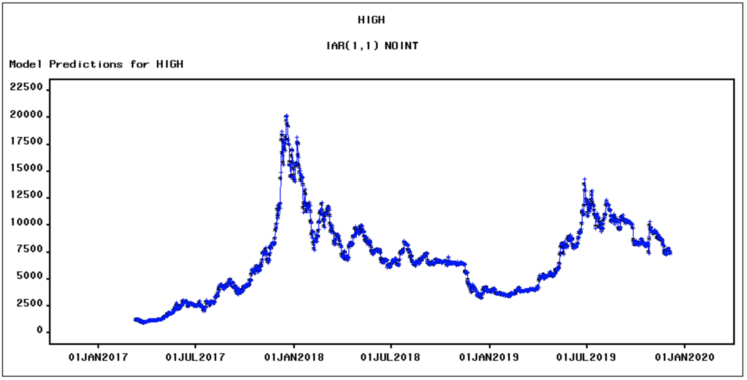
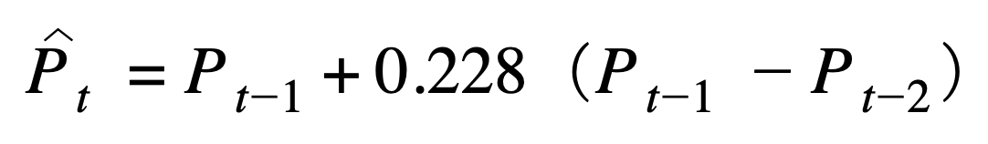
ARIMA（1，1，0）
Check Intercept
Check Statistic of Fit
Notes:
When we built the model, Since we mentioned that p could be 2 or 1, we built ARIMA(2,1,0) first. However, the p-value of the lag 2 is not significant shown at top left table. we decide to build ARIMA(1,1,0) instead.
Then, we built the model with Intercept. However, it seems like the intercept is not significant since the P-value is not small enough. So we built the model without intercept. From the model prediction plot, we can see the performance of the fitted model is good. The estimate coefficient is 0.228 and the p-value is small which means significant. Also we need to check errors.From table at middle right, The Mean Square Error is 26 thousand 5 hundred and 30.9. The Mean Absolute percent error is around 1.4968, which means there was about 1.5% data could not fit in the model. Since the Mean absolute percent error is very small and the R square 0.948 is big, we can say the model predictions performs good. The final equation for predicting “High” price of Bitcoin from ARIMA(1,1,0) is shown at right bottom.

Slide 11
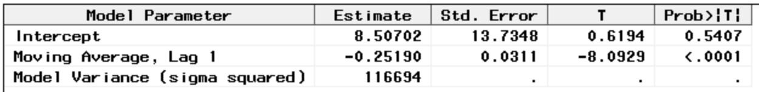
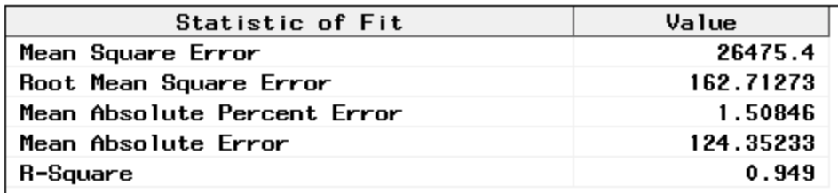
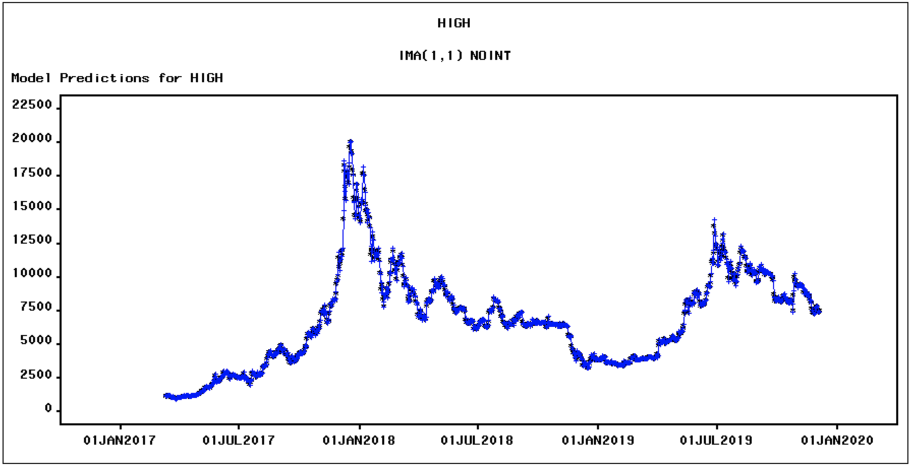
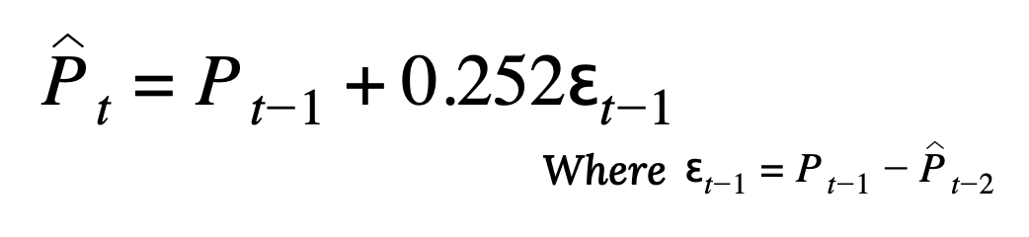
ARIMA（0，1，1）
Check Intercept
Check Statistic of Fit
Notes:
Then, we also tried to build ARIMA(0,1,1) model with Intercept. Also, it seems like the intercept is not significant since the P-value is not small enough so we build without intercept. From the model prediction plot, we can see the performance of the fitted model is good. The estimate coefficient is -0.252, and the p-value is small which means significant. Also we need to check errors.From table at top right, The Mean Square Error is 26 thousand 4 hundred and 75.4. The Mean Absolute percent error is around 1.51, which means there was about 1.51% data could not fit in the model. Since the Mean absolute percent error is very small and the R square 0.949 is big, we can say the model predictions performs good. The final equation for predicting “High” price of Bitcoin from ARIMA(0,1,1) is shown at right corner.
Shengqi will discuss how we evaluate hold out sample and the comparison between models.

Slide 12
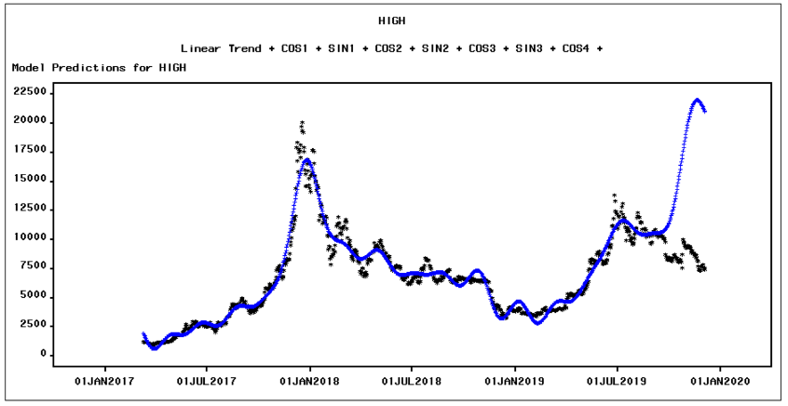
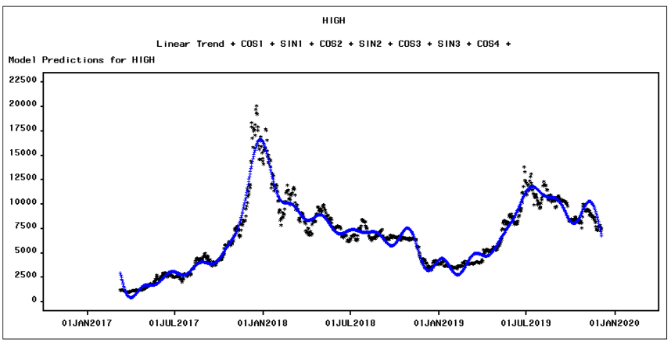
Decision of hold out sample
4
85 hold out sample
30 hold out sample
Notes:
Now, I wanna talk about why we choose 30 - 40 hold-out sample, instead of 15% of data. Since we have 1000 daily observations, if we choose 85-150 hold-out sample, the series’ training set will cover all data before July 2019. However, we can see that the trend from January 2019 to July 2019 is only increasing, so based on that, it will only predict an increasing trend, but from the plot of the original series, we can clearly see a turning point after July 2019, which shows the actual trend is decreasing after July 2019. Therefore, the right size of a hold-out sample should be relatively small, and it also needs to contain data after the turning point. Therefore, we choose 30-40 hold out sample. It is big enough to fit and cover the decreasing trend.
Also, here is the comparison of 85 hold-out sample and 30 hold out sample, we can clearly see the predicted trend.

Slide 13
Models Comparison
Hold Out | Models | MAPE | MAE | RMSE | R-Square
30 | Cyclical+AR(2) | 2.10944 | 174.94778 | 201.75939 | 0.921
30 | IAR(1,1) | 1.49682 | 123.32323 | 162.88315 | 0.948
 | IMA(1,1) | 1.50846 | 124.35233 | 162.71273 | 0.949
15 | IAR(1,1) | 1.54067 | 117.84266 | 161.91157 | 0.620
 | IMA(1,1) | 1.55198 | 118.71474 | 162.39881 | 0.618
Notes:
Here is a table shown the comparison of different models based on some relevant statistic fit. We can see from the table, the MAPE of ARIMA(1,1,0) model with 30 hold out is smaller comparing to other models, which is 1.49. and the R-squared is also pretty large, even though the R-squared of ARIMA(0,1,1) model with 30 hold out is larger, but the difference of R-squared between these two models is not that significant, so, we decide to choose the ARIMA(1,1,0) model.
Junzhe will continue on TF model.

Slide 14
Transfer Function Model
5
Relationship between High and Volume
Based on the CCF find the parameters of TF
Check residuals and make TF noise model
Notes:
whether we need a TF noise model.

Slide 15
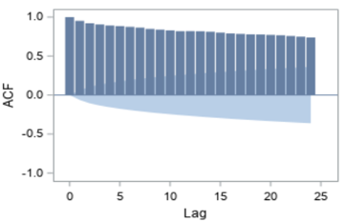
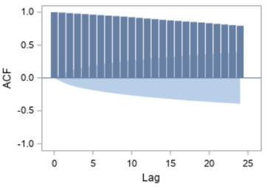
ACF of Volume
ACF of High
Volume as X
High as Y
Notes:
we do not need further action towards this series.

Slide 16
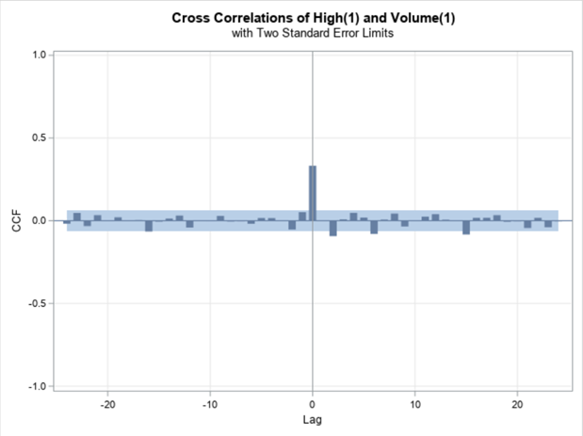
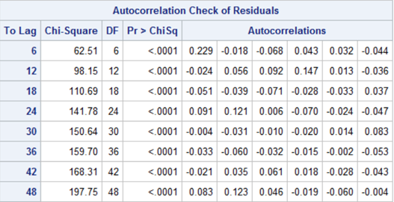
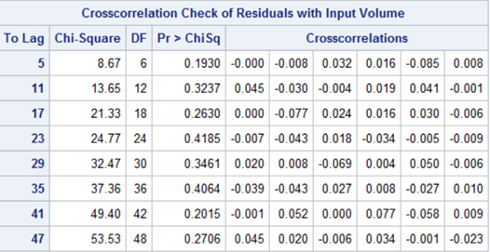
CCF of High(1) and Volume(1)
Check of Residuals
Notes:
And Based on the ACF and PACF plot of residuals, MA(1) model is the best noise model.

Slide 17
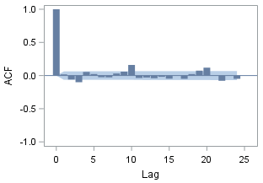
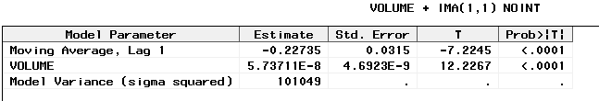
Parameters estimation of TF model
ACF of Residuals
after MA(1) Noise model
Notes:
And the fluctuations of market trading affect the value of the highest price immediately

Slide 18
Thanks!
Any questions ?

